Slide 1

Debouncing and Throttling
Rosie Prom
Event handling in a performant way.
Notes:
Short intro about myself, what my topic is about and what you can learn from it

Slide 2
Debouncing & Throttling
Talk Agenda
What is Debouncing?
What is Throttling?
Debouncing vs Throttling examples
Summary
Notes:
In this lightning talk, we will define what debouncing is and what throttling is, then we will look at the difference between these two with examples. We will then know how to use this in our code. By the end of this talk, you should learn what Throttling is and what Debouncing is!

Slide 3
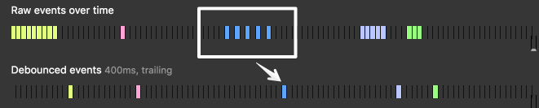
Debouncing allows us to group sequential calls together.
Notes:
Debounce and throttle are two but very similar techniques we can use to control how often a function can be executed overtime.
Debouncing allows us to group sequential calls together, which will enable us to control or limit the rate of when these events fire off.
As you can see in the worked example, we have events that are pre-registered in the top row, and the debounced events are being shown below.

Slide 4
Debouncing in Keystroke Events
1. Avoid unnecessary network calls by firing a request after the user has stopped typing.
2. Improved feedback for people entering their passwords
Notes:
Debouncing in keystroke events is one of the many ways you can use debouncing.
When we use debouncing, we are able to fire off events all at once with a delay.
In this example, we are entering a password, and we want to verify the text entered after we have stopped typing.
We’d use Debouncing to avoid listening for each keystroke event to happen to then process the value that this input has taken.
Using debouncing can benefit performance by allowing control over how we handle repetitive events like keystrokes, to then off-load pressure on API calls on networks, we can also

Slide 5
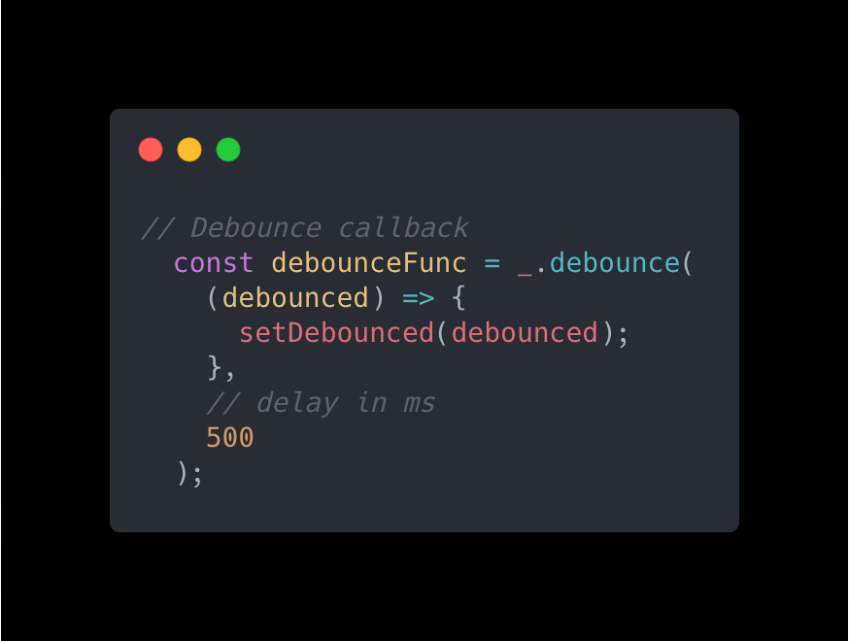
Practical Example
Notes:
By using the Lodash library, we are able to call debounce to debounce our keystroke events, and then invoking them on our square.

Slide 6
Throttling guarantees the execution of the function regularly, at least at X milliseconds.
Notes:
Throttle is basically, listening to the number of times a function is being executed over a period of time.
In other words, when we are delaying an execution of a function, which will reduce how often our events will fire off.

Slide 7
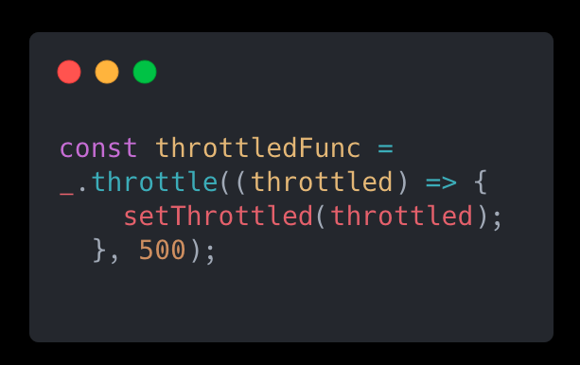
Throttling on Scroll Events
1. We are able to constantly check how far is the user from the bottom and act accordingly.
2. We have the option to store ignored executions and execute them last.
Notes:
Throttling can be best used for things such as infinite scrolling, where we would need to continuously load elements onto the screen as we scroll down.
We’d use Throttling over Debouncing for use-cases like this because we are able to constantly check how far we are from the bottom and then render more elements onto the screen, like so.
The major advantage of throttle over debounce is that we have the option to store ignored executions and execute them at last after all the function calls are made. This can be very effective when we want to read where our mouse is on the screen, and do some fancy thing on our DOM.

Slide 8
Notes:
Here, we have a side by side comparison of a Debounced behaviour and a Throttled behaviour. We are able to see that the colour of the square and the text underneath changes practically straight away compared to the Debounce where it “groups” the keystroke events together then chucks it all out at once.

Slide 9
In Summary
Debouncing will bunch a series of sequential calls to a function into a single call to that function.
Throttling will delay executing a function. It will reduce the notifications of an event that fires multiple times.
Notes:
In summary, we learned what Debouncing and Throttling are.
Debouncing is when we group a series of events, then we process them to a single call to that function. It ensures that one notification is made for an event that fires multiple times.
A good use-case of Debouncing is in password or form validation, or if you want something to hide off the screen after you scroll down the page.
Throttling is when we are delaying an execution of a function, which will reduce how often our events will fire off.
A good example that we have went through is using Throttling in infinite scroll, we we want to constantly check to see how far we are from the bottom of the screen.
When deciding which pattern to use, we should be mindful of what the desired outcome should be.

Slide 10
Credits & Thank You!
Working example: https://github.com/rosieprom/my-throttling-debouncing
CSS Tricks article: https://css-tricks.com/debouncing-throttling-explained-examples/
Lodash library: https://lodash.com/docs/
Shout outs to my team at x15: Ethan, Will, Kelvin & James 🤗

